Slide 1
Chapter 3
Stoichiometry

Slide 2
3.1 Counting by Weighing
3.2 Atomic Masses
3.3 The Mole
3.4 Molar Mass
3.5 Learning to Solve Problems
3.6 Percent Composition of Compounds
3.7 Determining the Formula of a Compound
3.10 Stoichiometric Calculations: Amounts of Reactants and Products
3.11 The Concept of Limiting Reagent

Slide 3
Chemical Stoichiometry
Stoichiometry – The study of quantities of materials consumed and produced in chemical reactions.

Slide 4
Elements occur in nature as mixtures of isotopes.
Carbon = 98.89% ¹²C
1.11% ¹³C
< 0.01% ¹⁴C

Slide 5
Average Atomic Mass for Carbon
98.89% of 12 amu + 1.11% of 13.0034 amu =
exact number
(0.9889)(12 amu) + (0.0111)(13.0034 amu) =
12.01 amu

Slide 6
Average Atomic Mass for Carbon
Even though natural carbon does not contain a single atom with mass 12.01, for stoichiometric purposes, we can consider carbon to be composed of only one type of atom with a mass of 12.01.
This enables us to count atoms of natural carbon by weighing a sample of carbon.

Slide 7
Mass Spectrometry
Mass spectrometry gives the mass to charge ratio
The relative size of the peaks indicates the relative number of particles
Separates isotopes according to mass
Used to find relative abundance and atomic/molar mass of unknown samples

Slide 8
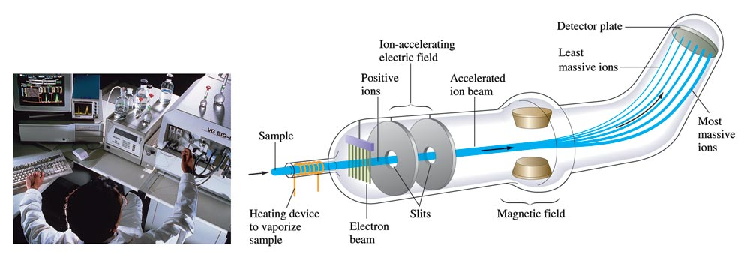
Schematic Diagram of a Mass Spectrometer

Slide 9
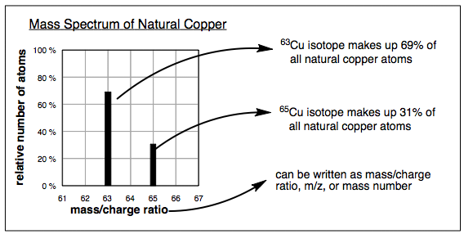
Mass Spectrometry

Slide 10
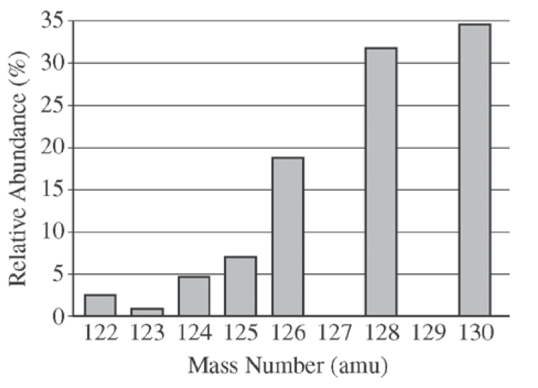
From the AP Sample Questions…
The elements I and Te have similar average atomic masses. A sample that was believed to be a mixture of I and Te was run through a mass spectrometer, resulting in the data above. All of the following statements are true. Which one would be the best basis for concluding that the sample was pure Te?

Slide 11
From the AP Sample Questions…
Te forms ions with a -2 charge, whereas I forms ions with a -1 charge.
Te is more abundant that I in the universe.
I consists of only one naturally occurring isotope with 74 neutrons, whereas Te has more than one isotope.
I has a higher first ionization energy than Te does.
Notes:
C – Since there is not a peak at 127 (the most common isotope for I), there can not be I in the sample.

Slide 12
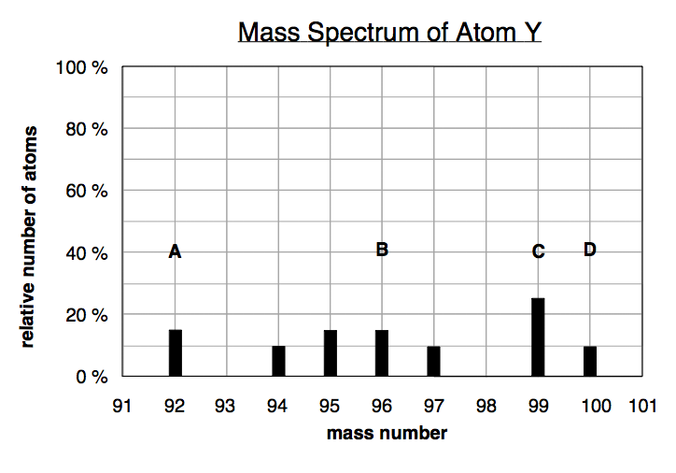
Based on the mass spectrum of atom Y, which of the following statements is false?
    a. peak A and peak D come from atoms that have the same number of electrons
    b. there are seven isotopes of atom Y
    c. peak C comes from the most abundant isotope of atom Y
    d. peak D comes from an atom with 4 more protons than the atom that gave peak B
Notes:
D – protons must be the same for atoms of the same element; neutrons make the difference on the spectrum assuming this is a single element

Slide 13

Exercise
An element consists of 62.60% of an isotope with mass 186.956 amu and 37.40% of an isotope with mass 184.953 amu.
Calculate the average atomic mass and identify the element.
186.2 amu
Rhenium (Re)
Notes:
Average Atomic Mass = (0.6260)(186.956 amu) + (0.3740)(184.953 amu) = 186.2 amu
The element is rhenium (Re).

Slide 14
The number equal to the number of carbon atoms in exactly 12 grams of pure ¹²C.
1 mole of anything = 6.022 x 10²³ units of that thing (Avogadro’s number).
1 mole C = 6.022 x 10²³ C atoms = 12.01 g C

Slide 15
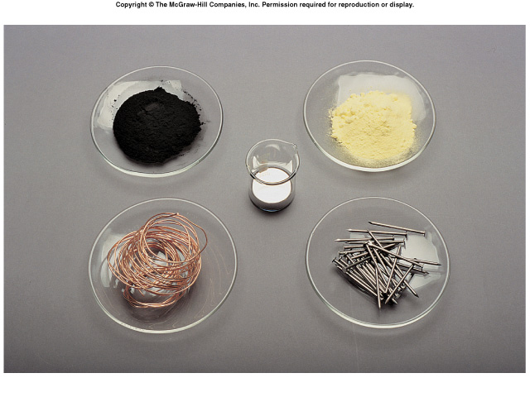
One Mole of:
C
S
Hg
Cu
Fe
3.2

Slide 16
Other units
Molarity
  Moles solute / L solution
Gases
  22.4 L = 1 mole of ANY GAS at STP

Slide 17

Concept Check
Calculate the number of iron atoms in a 4.48 mole sample of iron.
2.70×10²⁴ Fe atoms
Notes:
(4.48 mol Fe) × (6.022×10²³ Fe atoms / 1 mol Fe) = 2.70×10²⁴ Fe atoms.

Slide 18
Mass in grams of one mole of the substance:
Molar Mass of N = 14.01 g/mol
Molar Mass of H₂O = 18.02 g/mol
(2 × 1.008 g) + 16.00 g
Molar Mass of Ba(NO₃)₂ = 261.35 g/mol
137.33 g + (2 × 14.01 g) + (6 × 16.00 g)

Slide 19
Concept Check
Which of the following is closest to the average mass of one atom of copper?
a) 63.55 g
b) 52.00 g
c) 58.93 g
d) 65.38 g
e) 1.055 x 10⁻²² g
Notes:
The correct answer is “e”. The mass of one atom of copper is going to be extremely small, so only letter “e” makes sense. The calculated solution is (1 Cu atom) × (1 mol Cu/6.022×10²³ Cu atoms) × (63.55 g Cu/1 mol Cu).

Slide 20
Concept Check
Calculate the number of copper atoms in a 63.55 g sample of copper.
6.022×10²³ Cu atoms
Notes:
6.022×10²³ Cu atoms; 63.55 g of Cu is 1 mole of Cu, which is equal to Avogadro’s number.

Slide 21
Conceptual Problem Solving
Where are we going?
  Read the problem and decide on the final goal.
How do we get there?
  Work backwards from the final goal to decide where to start.
Reality check.
  Does my answer make sense? Is it reasonable?

Slide 22
Mass percent of an element:
For iron in iron(III) oxide, (Fe₂O₃):

Slide 23
Formulas
Empirical formula = CH
  Simplest whole-number ratio
Molecular formula = (empirical formula)_{n} [n = integer]
Molecular formula = C₆H₆ = (CH)₆
  Actual formula of the compound

Slide 24
Exercise
The composition of adipic acid is 49.3% C, 6.9% H, and 43.8% O (by mass). The molar mass of the compound is about 146 g/mol.
  What is the empirical formula?
  C₃H₅O₂
  What is the molecular formula?
  C₆H₁₀O₄
Notes:
Assume 100.0g. 49.3 g of carbon is 4.105 mol C (49.3/12.01). 6.9 g of hydrogen is 6.845 mol H (6.9/1.008). 43.8 g of oxygen is 2.7375 mol O (43.8/16.00). The ratio of C:H:O is 1.5:2.5:1 (C: 4.105/2.7375 = 1.5; H: 6.845/2.7375 = 2.5). Multiplying each by 2 to get a whole number becomes a ratio of 3:5:2. The empirical formula is therefore C₃H₅O₂. The molar mass of the empirical formula is 73.07 g/mol, which goes into the molar mass of the molecular formula 2 times (146/73.07). The molecular formula is therefore C₆H₁₀O₄.

Slide 25
The balanced equation represents an overall ratio of reactants and products, not what actually “happens” during a reaction.
Use the coefficients in the balanced equation to decide the amount of each reactant that is used, and the amount of each product that is formed.

Slide 26
Calculating Masses of Reactants and Products in Reactions
1. Balance the equation for the reaction.
2. Convert the known mass of the reactant or product to moles of that substance.
3. Use the balanced equation to set up the appropriate mole ratios.
4. Use the appropriate mole ratios to calculate the number of moles of desired reactant or product.
5. Convert from moles back to grams if required by the problem.

Slide 27
Calculating Masses of Reactants and Products in Reactions

Slide 28
Exercise
Consider the following reaction:
P_{4 (s)} + 5 O_{2 (g)} → 2 P₂O₅ _{(s)}
If 6.25 g of phosphorus is burned, what mass of oxygen does it combine with?
8.07 g O₂
Notes:
(6.25 g P₄)(1 mol P₄ / 123.88 g P₄)(5 mol O₂ / 1 mol P₄)(32.00 g O₂ / 1 mol O₂) = 8.07 g O₂

Slide 29
Exercise (Part I)
Methane (CH₄) reacts with the oxygen in the air to produce carbon dioxide and water.
Ammonia (NH₃) reacts with the oxygen in the air to produce nitrogen monoxide and water.
  Write balanced equations for each of these reactions.
Notes:
CH₄ + 2O₂ → CO₂ + 2H₂O
4NH₃ + 5O₂ → 4NO + 6H₂O

Slide 30
Exercise (Part II)
Methane (CH₄) reacts with the oxygen in the air to produce carbon dioxide and water.
Ammonia (NH₃) reacts with the oxygen in the air to produce nitrogen monoxide and water.
  What mass of ammonia would produce the same amount of water as 1.00 g of methane reacting with excess oxygen?
Notes:
1.42 g of ammonia is required. Use the balanced equations from the previous exercise to start this problem. Determine the amount of water produced from 1.00 g of methane (which is 0.125 moles of water). Use the moles of water and the balanced equation to determine the amount of ammonia needed.
See the “Let’s Think About It” slide next to get the students going.

Slide 31
Let’s Think About It
Where are we going?
  To find the mass of ammonia that would produce the same amount of water as 1.00 g of methane reacting with excess oxygen.
How do we get there?
  We need to know:
    How much water is produced from 1.00 g of methane and excess oxygen.
    How much ammonia is needed to produce the amount of water calculated above.

Slide 32
Limiting Reactants
Limiting reactant – the reactant that is consumed first and therefore limits the amounts of products that can be formed.
Determine which reactant is limiting to calculate correctly the amounts of products that will be formed.

Slide 33
Limiting Reactants

Slide 34
Limiting Reactants
Methane and water will react to form products according to the equation:
CH₄ + H₂O → 3H₂ + CO

Slide 35
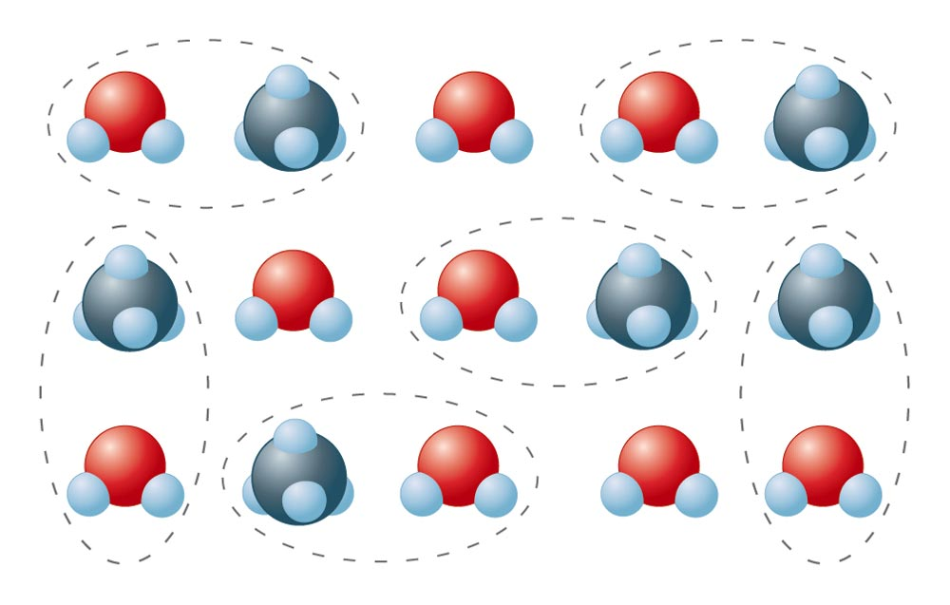
Mixture of CH₄ and H₂O Molecules Reacting

Slide 36
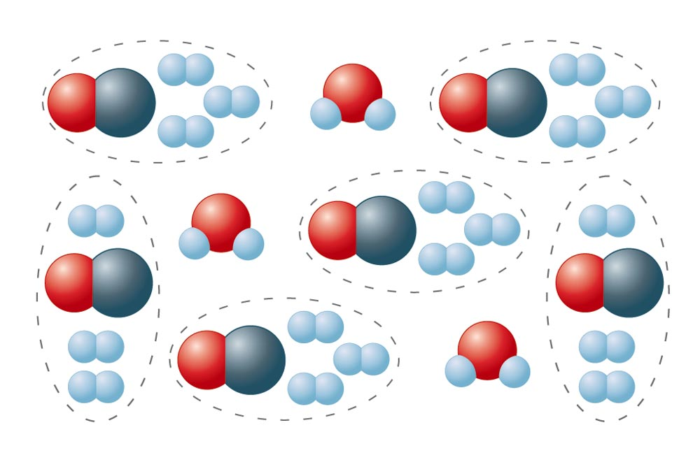
CH₄ and H₂O Reacting to Form H₂ and CO

Slide 37
Limiting Reactants
The amount of products that can form is limited by the methane.
Methane is the limiting reactant.
Water is in excess.

Slide 38
Concept Check
Which of the following reaction mixtures could produce the greatest amount of product? Each involves the reaction symbolized by the equation:
  2H₂ + O₂ → 2H₂O
    a) 2 moles of H₂ and 2 moles of O₂
    2 moles of H₂ and 3 moles of O₂
    2 moles of H₂ and 1 mole of O₂
    d) 3 moles of H₂ and 1 mole of O₂
    e) Each produce the same amount of product.
Notes:
The correct answer is “e”. All of these reaction mixtures would produce two moles of water.

Slide 39
Notice
We cannot simply add the total moles of all the reactants to decide which reactant mixture makes the most product. We must always think about how much product can be formed by using what we are given, and the ratio in the balanced equation.

Slide 40
Method 1
Pick A Product
Try ALL the reactants
The lowest answer will be the correct answer
The reactant that gives the lowest answer will be the limiting reactant

Slide 41
Limiting Reactant: Method 1
Limiting
Reactant
10.0g of aluminum reacts with 35.0 grams of chlorine gas to produce aluminum chloride. Which reactant is limiting, which is in excess, and how much product is produced?
2 Al + 3 Cl₂ → 2 AlCl₃
Start with Al:
Now Cl₂:
10.0 g Al 1 mol Al 2 mol AlCl₃ 133.5 g AlCl₃
27.0 g Al 2 mol Al 1 mol AlCl₃
= 49.4g AlCl₃
35.0g Cl₂ 1 mol Cl₂ 2 mol AlCl₃ 133.5 g AlCl₃
71.0 g Cl₂ 3 mol Cl₂ 1 mol AlCl₃
= 43.9g AlCl₃

Slide 42
Solving for Multiple Products
Once you determine the LR, you should only start with it!
A + B → X + Y + Z
A → X
B → X
To find Y and Z
B → Y
B → Z
Let’s say B is the LR!
There is no need to use A to find Y and Z
It will give you the wrong answer – a lot of extra work for nothing

Slide 43
Method 2
Convert one of the reactants to the other REACTANT
See if there is enough reactant “A” to use up the other reactants
If there is less than the GIVEN amount, it is the limiting reactant
Then, you can find the desired species

Slide 44
Percent Yield
An important indicator of the efficiency of a particular laboratory or industrial reaction.

Slide 45
Exercise
Consider the following reaction:
P₄(s) + 6F₂(g) → 4PF₃(g)
  What mass of P₄ is needed to produce 85.0 g of PF₃ if the reaction has a 64.9% yield?
  46.1 g P₄
Notes:
64.9% = (85.0 g PF₃ / x)(100); x = 130.97 g PF₃
(130.97 g PF₃)(1 mol PF₃ / 87.97 g PF₃)(1 mol P₄ / 4 mol PF₃)(123.88 g P₄ / 1 mol P₄) = 46.1 g of P₄ needed

